Slide 1
Linear Algebra

Slide 2
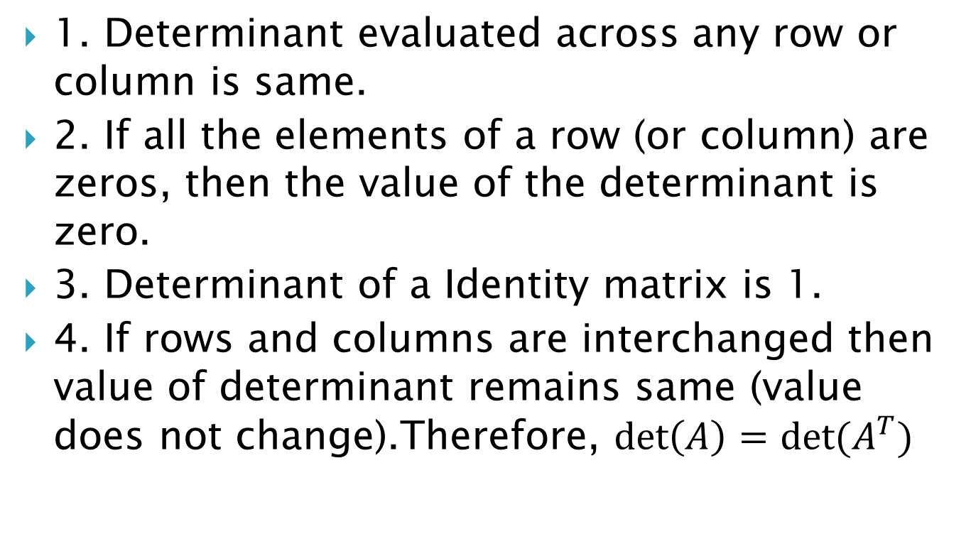
Properties of determinants
1. Determinant evaluated across any row or column is same.
2. If all the elements of a row (or column) are zeros, then the value of the determinant is zero.
3. Determinant of a Identity matrix is 1.
4. If rows and columns are interchanged then value of determinant remains same (value does not change).Therefore, $\det\left(A\right)=det⁡(A^{T})$

Slide 3
5. If any two row (or two column) of a determinant are interchanged the value of the determinant is multiplied by (-1).
6. If all elements of a row (or column) of a determinant are multiplied by some scalar number k, the value of the new determinant is k times of the given determinant.
7. If the all elements of a row (or column) are proportional (identical) to the elements of some other row (or column), then the determinant is zero.

Slide 4

Cramer’s Rule
Let’s consider the system of equations
$\left\{\begin{aligned}a_{11}x+a_{12}y+a_{13}z=b_{1} \\ a_{21}x+a_{22}y+a_{23}z=b_{2} \\ a_{31}x+a_{32}y+a_{33}z=b_{3}\end{aligned}\right.$

Slide 5

This system can be written in matrix form :
$\left(\begin{matrix}a_{11} & a_{12} & a_{13} \\ a_{21} & a_{22} & a_{23} \\ a_{31} & a_{32} & a_{33}\end{matrix}\right)\left(\begin{matrix}x \\ y \\ z\end{matrix}\right)=\left(\begin{matrix}b_{1} \\ b_{2} \\ b_{3}\end{matrix}\right)$ , or $A\overline{x}=\overline{b}$ .

Slide 6
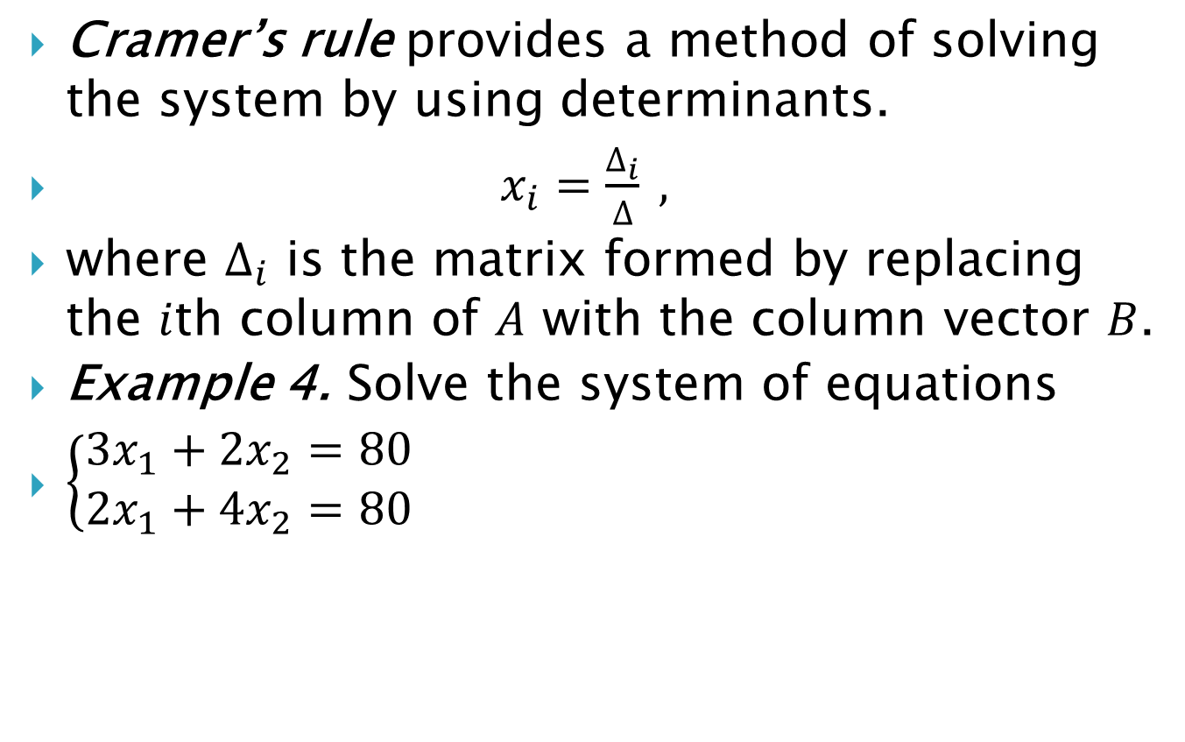
Cramer’s rule provides a method of solving the system by using determinants.
$x_{i}=\frac{∆_{i}}{∆} ,$
where $∆_{i}$ is the matrix formed by replacing the $i$th column of $A$ with the column vector $B$.
Example 4. Solve the system of equations
$\left\{\begin{aligned}3x_{1}+2x_{2}=80 \\ 2x_{1}+4x_{2}=80\end{aligned}\right.$

Slide 7
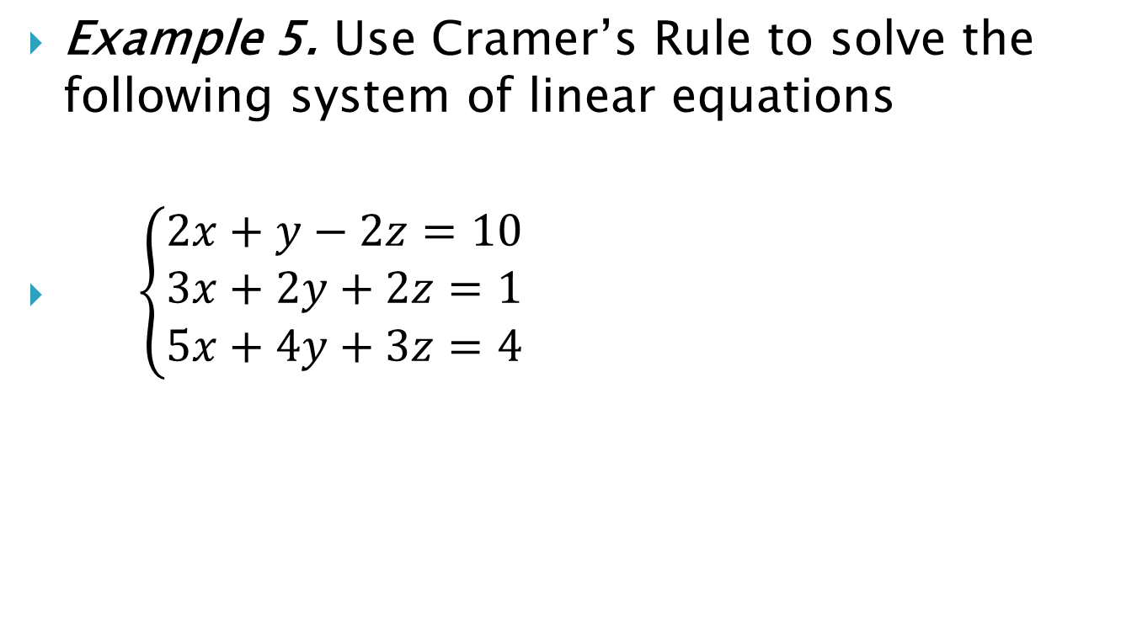
Example 5. Use Cramer’s Rule to solve the following system of linear equations
$\left\{\begin{aligned}2x+y−2z=10 \\ 3x+2y+2z=1 \\ 5x+4y+3z=4\end{aligned}\right.$

Slide 8

Example 6. Solve the system of equations using Cramer’s Rule
$\left\{\begin{aligned}3x+5z=14 \\ x+4y−2z=−10 \\ x+y+z=2\end{aligned}\right.$

Slide 9
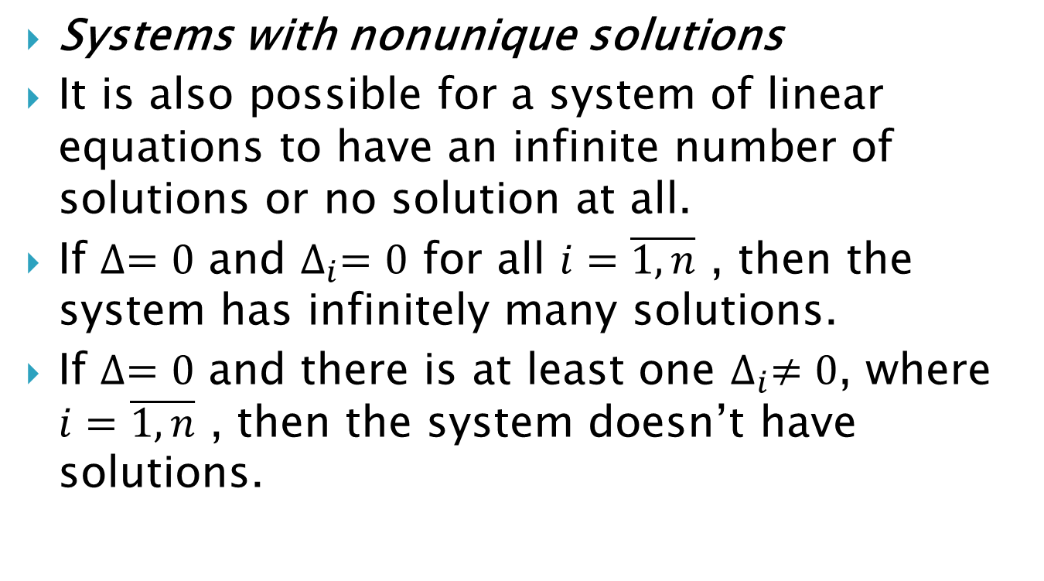
Systems with nonunique solutions
It is also possible for a system of linear equations to have an infinite number of solutions or no solution at all.
If $∆=0$ and $∆_{i}=0$ for all $i=\overline{1, n}$ , then the system has infinitely many solutions.
If $∆=0$ and there is at least one $∆_{i}≠0$, where $i=\overline{1, n}$ , then the system doesn’t have solutions.

Slide 10

Example 7. Solve the system of equations
$\left\{\begin{aligned}x+y+z=20 \\ 2x−3y+z=−5 \\ 6x−4y+4z=30\end{aligned}\right.$

Slide 11
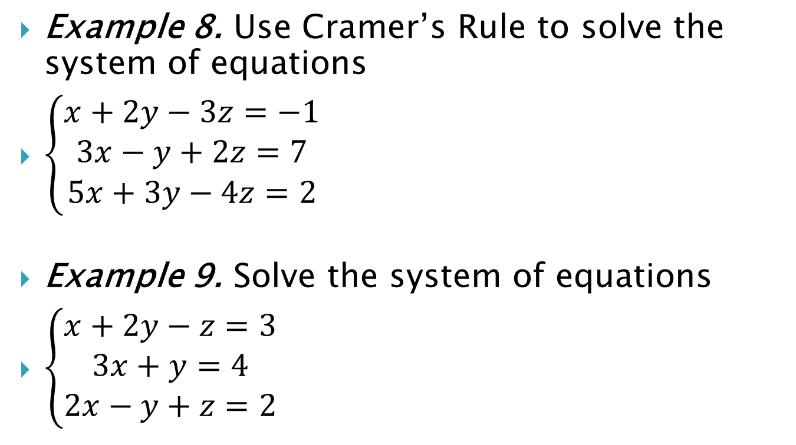
Example 8. Use Cramer’s Rule to solve the system of equations
$\left\{\begin{aligned}x+2y−3z=−1 \\ 3x−y+2z=7 \\ 5x+3y−4z=2\end{aligned}\right.$
Example 9. Solve the system of equations
$\left\{\begin{aligned}x+2y−z=3 \\ 3x+y=4 \\ 2x−y+z=2\end{aligned}\right.$

